Slide 1
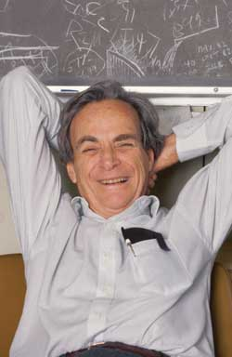
Can we build individual molecules atom by atom? Lecture 3

Slide 2
Yesterday we
Talked about basic molecular physics
Found that di-atomic molecules are indeed physics
Talked about the molecular dipole operator

Slide 3

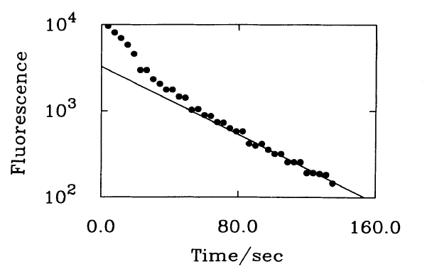
A bit of history

Slide 4
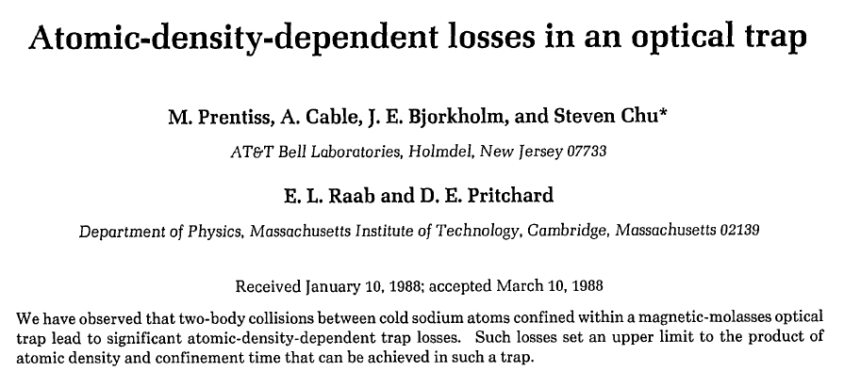
The follow up

Slide 5

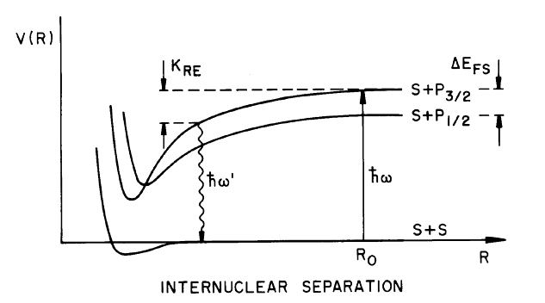
Gallagher-Pritchard

Slide 6
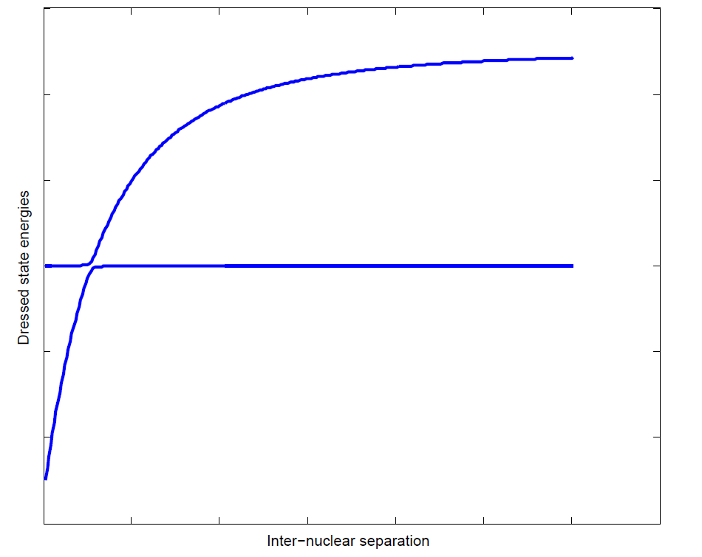

Dressed states

Slide 7
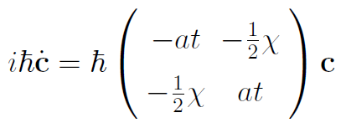
Landau-Zener

Slide 8


How to derive

Slide 9
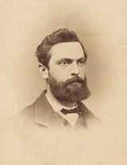
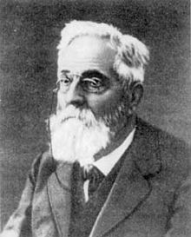
Is that Weber the Physicist or Weber the Mathematician
Heinrich F. Weber
Heinrich M. Weber

Slide 10
What is H. F. Weber best known for?

Slide 11
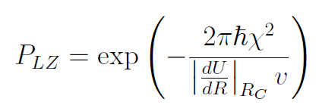
Landau-Zener formula

Slide 12

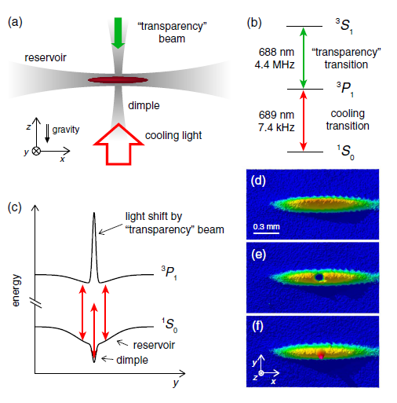
BEC without evaporative cooling

Slide 13

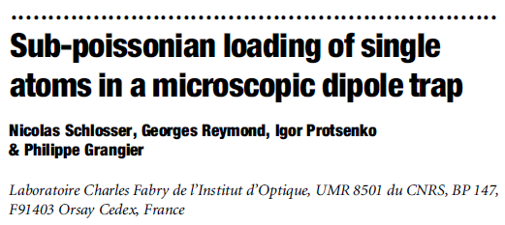
It is not a problem it is a feature

Slide 14
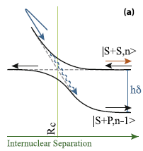
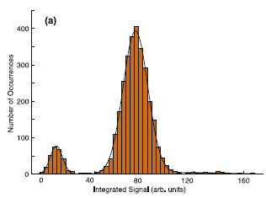
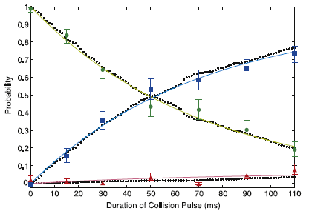

And even better

Slide 15
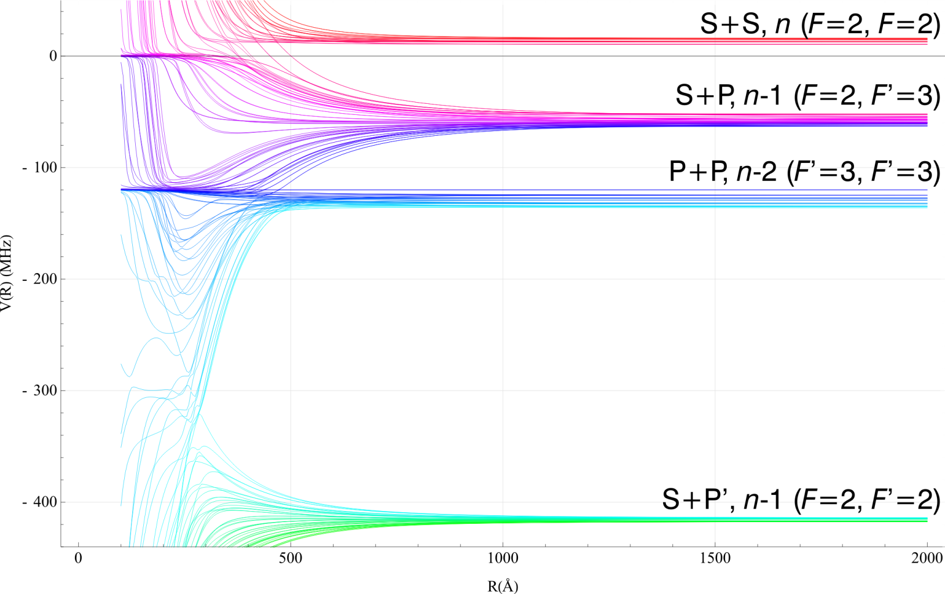
Multi-level structure
Figure: Thad Walker

Slide 16
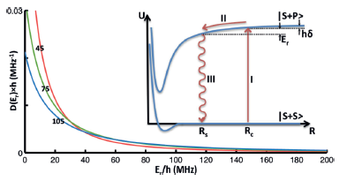
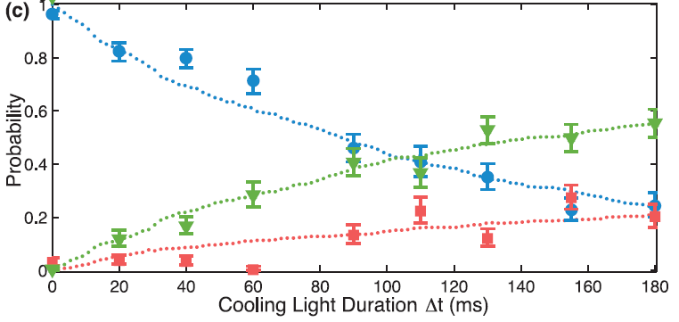
Forming individual molecules

Slide 17
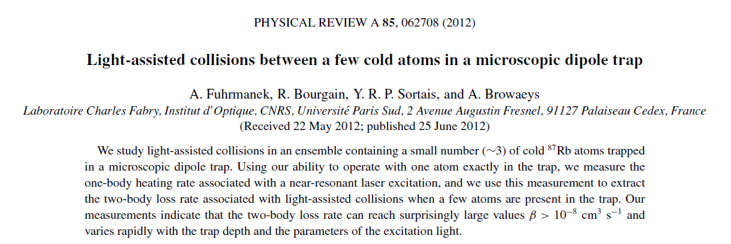
A side comment

